Slide 1
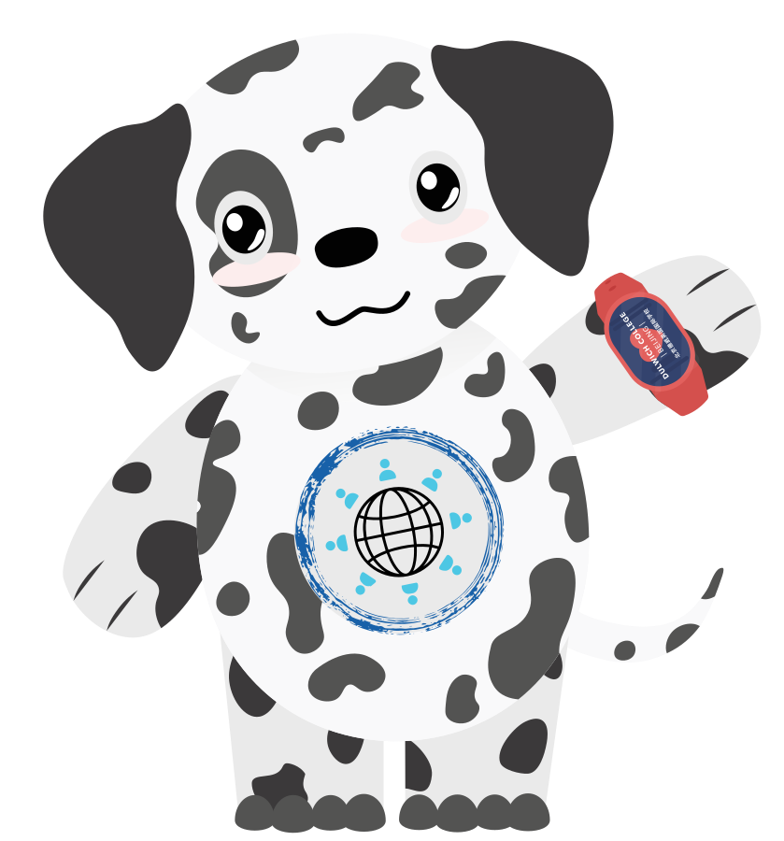
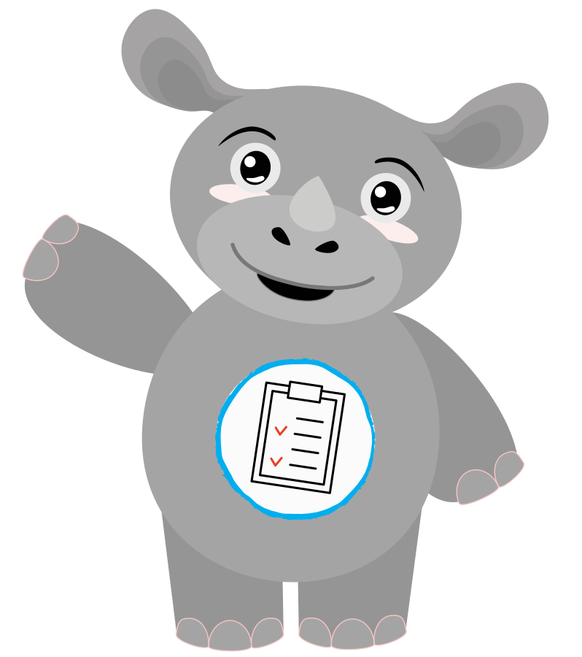
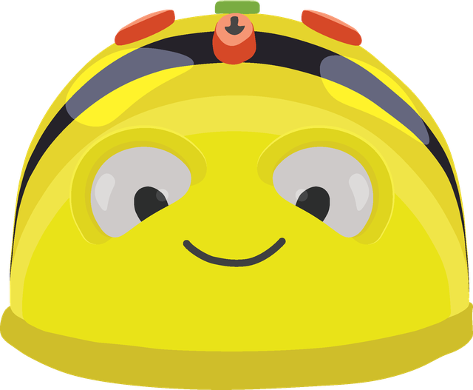
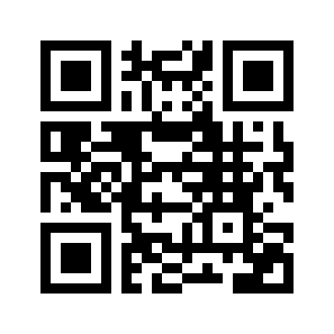
Before the prompt.
ACAMIS ECE 2026
XIAMEN · 24–25 OCTOBER
Play, trust and agency in early childhood
Tim Pyles · Mister Pyles
Learning Technology Coach and Whole College E-Safety Lead, Dulwich College Beijing
www.misterpyles.com
Notes:
As people arrive: the Dilon plush is at the door beside the door chart (kit page 3), with dot stickers. Put a QR code to the companion site in the top-right box before Saturday.
0:00. One line on who I am: Learning Technology Coach and Whole College E-Safety Lead at Dulwich College Beijing. The promise for the next 45 minutes: we start with you, travel through Dilon’s classroom, then you make it yours. You leave with an audit, a plan and a first step.
Nothing today asks a child to use generative AI. Hesitation is welcome here.

Slide 2
Twelve stops in 45 minutes
TODAY’S ADVENTURE
Today’s outcome: one idea, one priority, one next step. Use the site to finish your detailed plan later.
1
2
3
4
Start with you
STOPS 1–4
Say hello
Join the site
Tech hunt
Hunt → tech plan
0–2 min
2–3 min
3–8 min
8–11 min
5
6
7
8
Inside Dilon’s classroom
STOPS 5–8
The latest episode
Nest to Year 2
Capture & share
Beebots & play
11–15 min
15–18 min
18–20 min
20–24 min
9
10
11
12
Make it yours
STOPS 9–12
The playhouse
Make Dilon yours
Check & build
Families
24–31 min
31–35 min
35–42 min
42–45 min
Notes:
0:30. The shape of the session. Every idea is experienced before it is explained, which mirrors how the lesson works for children. The last twenty minutes belong to you: a playhouse, a character, an audit and a plan. If anyone is sceptical: good. Early childhood educators protect play and relationships, and those instincts belong in this work.
Minimum workshop outcome: one idea, one priority and one next step. Character details, full audit, detailed planning and peer feedback are optional follow-up if time is short. QR points to the main www.misterpyles.com address, as requested; workshop extension still to be hosted.

Slide 3
Start with you
CHAPTER 1 · STOPS 1–4
Your feelings, your spaces, and what they tell a tech plan
1 Say hello
2 Join the site
3 Tech hunt
4 Hunt → tech plan
Notes:
Transition. “Before we look at any classroom, let’s start with you.”

Slide 4
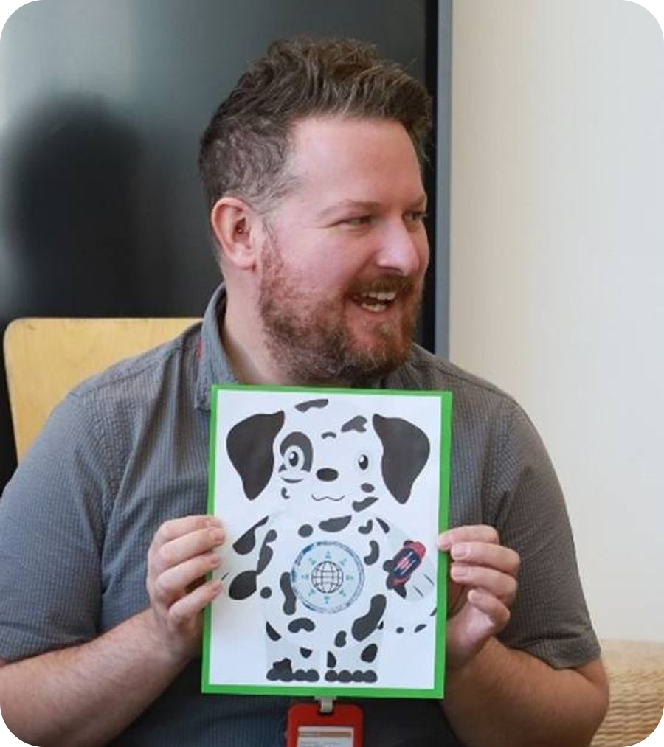





Say hello to Dilon. Where are you today?
STOP 1 · SAY HELLO
0–2 min
How do you feel about AI in early childhood today?
今天，您对幼儿教育中的人工智能有什么感受？
Worried
Wary
Unsure
Curious
Excited
担心
谨慎
不确定
好奇
兴奋
Pop a dot on the door chart. On the site, tap a face: it goes onto your audit PDF, and we’ll move it at the very end.
Hello, Dilon!
Notes:
0:00 to 2:00, while people arrive. Hold up the plush and say hello to Dilon. Invite everyone to wave back (most will!).
Ask: how do you feel about AI in early childhood today? Worried, wary, unsure, curious or excited. Dots on the door chart, and on the site a tap on a face. No discussion yet: “We’ll come back to these at the end, and you can move yours.”

Slide 5





You’re in. Keep this tab open
STOP 2 · JOIN THE SITE
2–3 min
My notes
In the corner of every page. Tap the pencil to jot an idea.
Your tech hunt drawing
Save it as a picture, or print it.
Playhouse ideas and your character
They flow straight into your plan.
www.misterpyles.com
PDFs to take away
Your workshop work is saved locally.
Notes, drawing, audit and plan, already filled in.
Notes:
2:00 to 3:00. Point to the QR code. The site is the notebook for the next 45 minutes and the toolkit afterwards: notes in the corner of every page, the tech hunt drawing, the playhouse and character. Notes, the drawing, the audit and the plan all download as filled-in PDFs on the Before the Prompt template. Nothing is sent anywhere; it all lives in their browser. Paper people: everything is in the table kit too.

Slide 6




What technology lives in your space?
STOP 3 · TECH HUNT
3–8 min
1
Choose a space you know
My living room
Home
Classroom
A friend’s house
Somewhere else
2
Draw it, or tap to add stickers
On paper: the drawing sheet and sticker sheet in your kit.
3
Tag what it can do
Listens
Watches
Connects
Suggests
Moves
Listens · 2
Watches · 2
Connects · 3
Notes:
3:00 to 8:00. Five minutes. “Before we look at any classroom, look at a space you know well: your home, your classroom, a friend’s house, anywhere.” Draw it on the site (or the A3 drawing sheet), or tap to add stickers of the technology that lives there. Then tag it: what listens, what watches, what connects to the internet, what suggests things?
Circulate and ask: what surprised you? Which space had the most? Stickers are generous guesses: a tablet can watch and connect, even if yours mostly plays songs.
The same hunt, with real objects and a “not sure” basket, is the first stop in Dilon Lesson 1.

Slide 7
What we find shapes what we plan
STOP 4 · HUNT → TECH PLAN
8–11 min
A tech hunt informs part of our tech plan and our safeguarding policy.
1
Where does it live?
Every device has a labelled home and a routine for going back.
Children notice
They find, sort and name the technology around them. That noticing is the lesson.
2
Who uses it, and with whom?
An adult nearby, two gentle hands, and “not sure? grab a grown-up”.
Adults decide
3
Does it listen, watch or connect?
Adults check what it collects and where it sends it. Photos follow media consent.
Which devices come in, what they collect and how they’re supervised.
4
What do children need to know?
Age-specific lessons, Nest to Year 2, carried by a character and repeated in play.
Families join in
What do families need to know?
Bilingual family notes, and short sessions on AI toys and what never to share.
The same questions go home, in home languages.
5
Notes:
8:00 to 11:00. A tech hunt isn’t only a lesson for children. What turns up in children’s spaces informs part of our tech plan and our safeguarding policy: where devices live, who is nearby, what they hear and see, and what children and families need to know.
Ask one table: which of your stickers would change a line in your policy? The principle on the right: keep adults responsible for tool decisions, and give children meaningful participation without making them responsible for managing system risks (UNICEF, 2025). At DCB this Early Years work is one strand of a whole-college approach; the route from borrowed lessons to an owned policy is in my companion workshop, E-Safety: Zero to Hero.

Slide 8
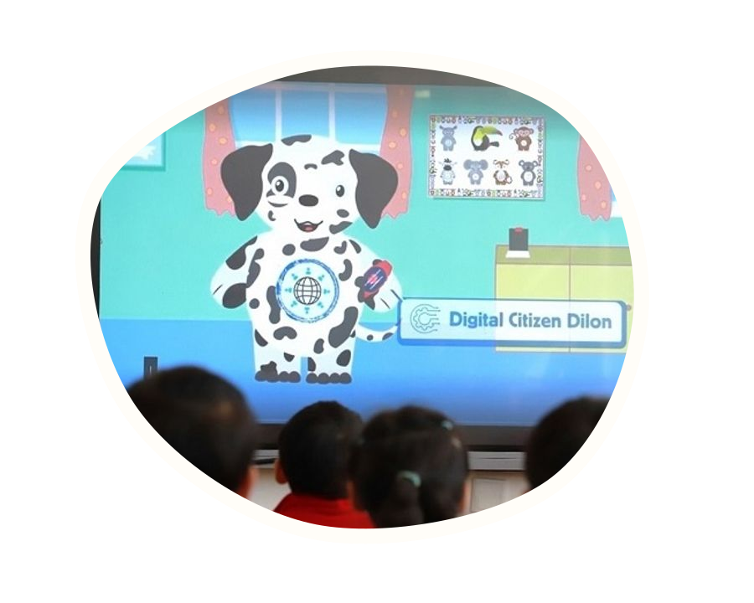
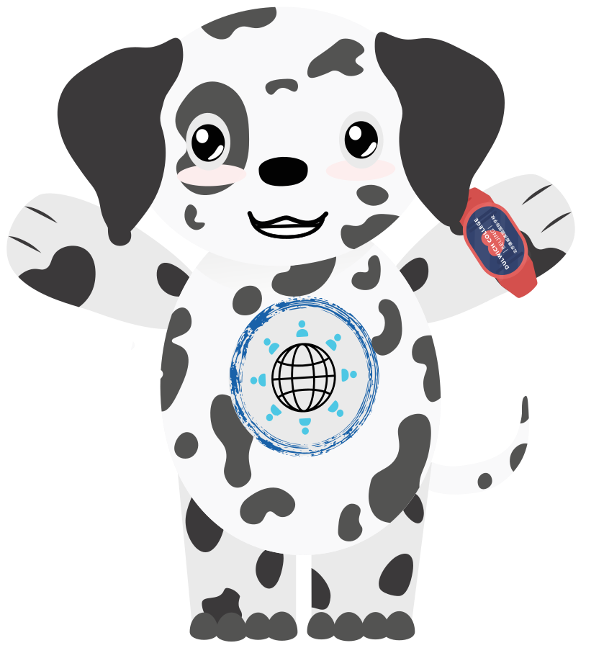
Inside Dilon’s classroom
CHAPTER 2 · STOPS 5–8
The latest episode, Nest to Year 2, and the play that grows the same ideas
5 The latest episode
6 Nest to Year 2
7 Capture & share
8 Beebots & play
Notes:
11:00. Transition. “Let me introduce you to the friend who made this possible.”

Slide 9

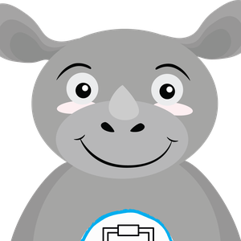

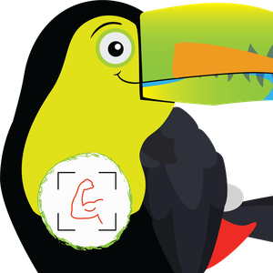

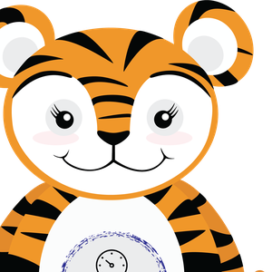

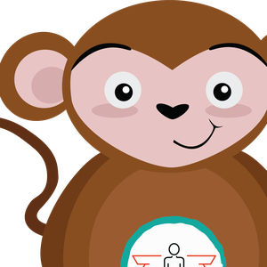
DCB’s values, brought to life
STOP 5 · THE VALUES FAMILY
11–15 min
In DUCKS, each college value is a friend teachers hold up in the room. Dilon joined as the eighth friend, for digital life.
Digital Citizen Dilon
Responsible Ryan
Kind Kate
Resilient Ren
DIGITAL CITIZENSHIP
RESPONSIBILITY
KINDNESS
RESILIENCE
I can use two gentle hands and put technology back in its home.
I can look after my classroom and know who to ask for help.
I can help others and use kind words.
I can keep on trying, and try a different way.
Open-minded Oli
Integrity Isabelle
Respectful Rui
Confident Cong
OPEN-MINDEDNESS
INTEGRITY
RESPECT
CONFIDENCE
I can be curious and use my senses to explore.
I can tell the truth when I have made a mistake.
I can listen, and be careful with other people’s things.
I can feel proud of how I do things, not just the result.
Notes:
11:00 to 12:00. DCB already had seven values friends that teachers hold up in the room, so a value becomes someone the children know and want to be like. Each friend has the same card for teachers: the value, “I can” statements, questions to ask, books, videos and songs, and words that mean the same. Several also link to the Early Years Characteristics of Effective Learning.
In my first year I pitched an eighth: Digital Citizen Dilon, for digital life. He carries digital citizenship by connecting to values children already know, not by adding a separate tech rulebook. Responsible Ryan is his partner in the lessons.

Slide 10
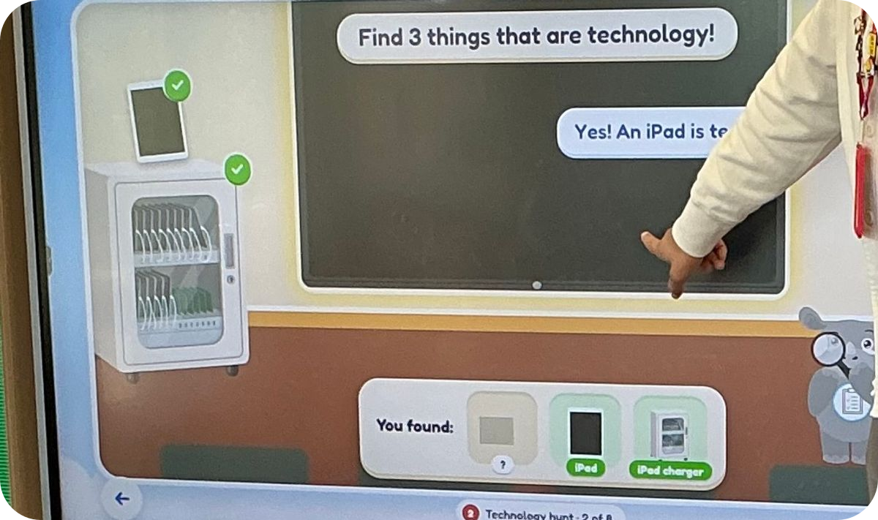
Lesson 1, on the class screen
STOP 5 · THE LATEST EPISODE
1
Say hello
5
Ryan’s choice
2
Technology hunt
6
Gentle hands
3
Watch together
7
Goodbye
4
Where does it go?
8
Our promise
STEP 7 · GOODBYE
Reception · Lesson 1 · Technology hunt
Teachers note that Dilon and the value friends don’t exist like we do, which is why we say bye.
Nest & Nursery Find the MAXHUB and the iPad. Model, then copy.
Reception Find three pieces of technology and explain each answer.
Notes:
12:00 to 13:00. The newest lesson is an interactive adventure played together on the class screen, with a teacher guide for each class. Say hello; find the technology in the classroom picture, then point to the real MAXHUB and iPads; watch together; flip the cards (technology has a home, never the floor); help Ryan choose where his iPad goes; drag the iPad to two gentle hands and practise with a pretend tablet; wave goodbye; make the promise and become a Responsible Helper.
Step 7 matters most to me: teachers note that Dilon and the value friends don’t exist like we do, which is why we say bye. Same lesson, two versions: Nest models, then copies; Reception finds three and explains why.

Slide 11
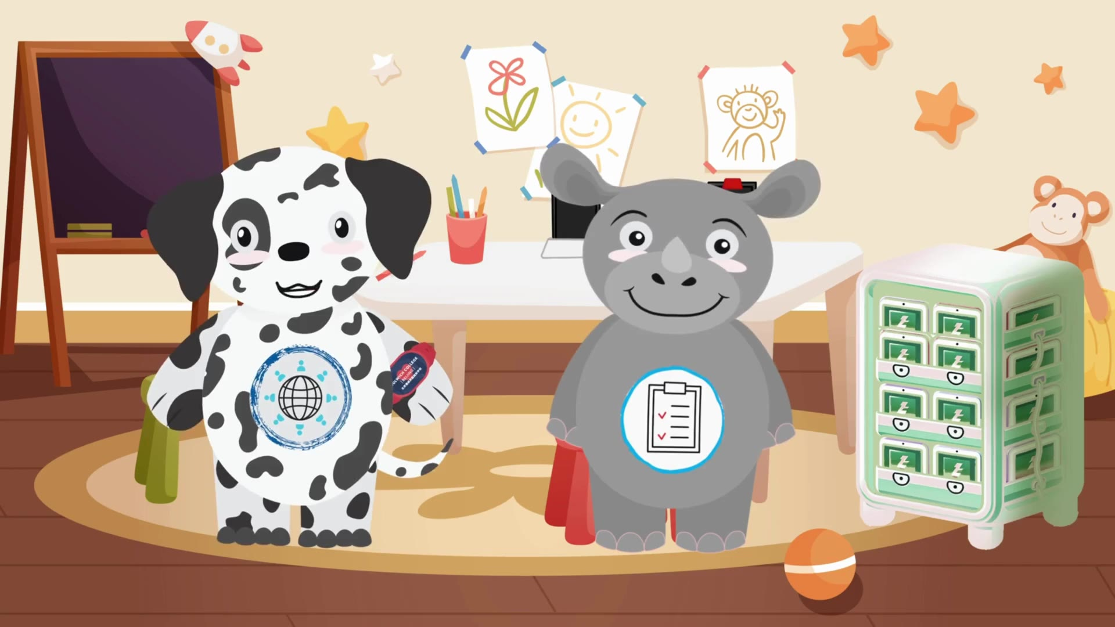
The screen is one short moment
STOP 5 · WATCH TOGETHER
Listen for
Dilon asks a question
Ryan answers with his value
iPads have a home
iPad care, with Dilon and Responsible Ryan · 0:58
Notes:
13:00. Play the 58-second clip (click the video). This is the “Watch together” moment from Lesson 1: iPad care. Point out how short it is. The screen is a doorway; everything that matters happens after it.
If the video will not play, it is also on the companion site under Dilon, and in the site folder at assets/video/dilon-lesson-1.mp4.
The site includes a written activity alternative. The existing video does not yet have a verified timed caption track; facilitate it with explanation and offer the written route.

Slide 12
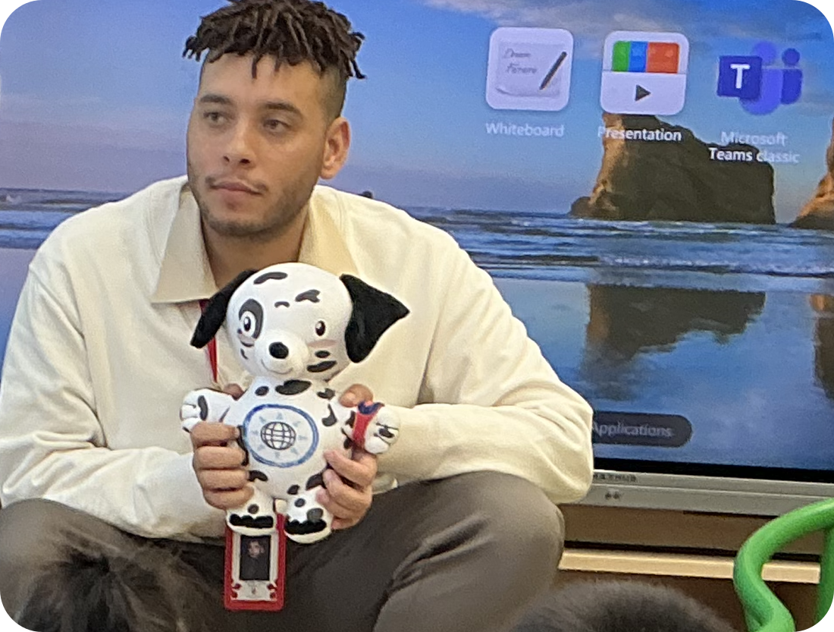
Classroom voices and revised wording
STOP 5 · CHILDREN’S VOICES
“I remember Dilon from last year!”
A Reception child, launching Digital Citizenship Week. Last year, they were in Nursery.
“We don’t want to lose Dilon’s technology.”
Revised adult phrase. “Let’s put it back so everyone can find it.”
Back to Dilon.
A child carried a Beebot from the carpet to the tech station to return it to Dilon.
Dilon’s station
“The most analog object in the room becomes their way into the most abstract ideas they will ever have to navigate.”
The other values friends have songs. Dilon didn’t, so I wasn’t sure he would connect.
Notes:
14:00 to 15:00. These are the moments I knew Dilon had landed. A Nursery colleague described how he slipped into everyday framing. What stayed with me came after: a child carried a Beebot from the carpet to the tech station, returning it to Dilon, whose cut-out (now the plush) watches over the technology.
Responsible Ryan and the other friends have songs; Dilon did not, so I was unsure how strongly he would connect. Students as young as three were excited to talk about him. One honest aside on the walkie-talkie quote: it shows how far Dilon has travelled into everyday talk, and it also gives him feelings children have to look after. “Let’s help it find its home” does the same job.
Hold up the plush. He looks unassuming, but he marks three years of deliberate work: something a three-year-old can hold in both hands, with his own place in class where children return technology. Unsure? Grab a grown-up.
If asked why a plush: toddlers who cared for a plush version of a character later learned more from that character on screen (Gola et al., 2013).

Slide 13
One message, rebuilt for each age
STOP 6 · NEST TO YEAR 2
15–18 min
Nest & Nursery
Reception
Year 1
Year 2
AGES 2–3
AGES 4–5
AGES 5–6
AGES 6–7
What is technology, and how do we use it safely with our bodies?
Technology is anywhere. How do we notice it?
Apps are part of technology and a digital world.
How do we use technology to be respectful and kind, including with ideas?
THE AI THREAD
THE AI THREAD
THE AI THREAD
THE AI THREAD
Machines are made by people. Dilon is pretend, so we wave goodbye when he goes.
Some technology listens or watches. What can it hear and see, and who made it?
Apps can suggest and guess. Who made the choice: me, a grown-up or the app?
When a machine helps make a picture or an idea, we still say who made what, and we check it.
Six scaffolded lessons per age group carry the same values. No child uses generative AI.
Notes:
15:00 to 17:00. What Nursery needs to hear about technology and AI is not what Year 2 needs to hear. Nest and Nursery: what technology is, and how we use it safely with our bodies. Reception: technology is anywhere, and how do we notice it. Year 1: apps are part of technology and a digital world. Year 2: how we use technology to be respectful and kind, including with ideas.
The AI thread grows with the children, and no child operates AI. These years are the “early foundations” of a Nursery-to-Year-13 AI literacy framework: noticing, questioning and choosing beside a trusted adult, so that when children do meet responsive systems they already have the habits.
[Tim: confirm the AI-thread line for each year matches your 2026 lessons.]

Slide 14
Using attachment to teach discernment
STOP 6 · THE HONEST PART
Familiar characters can support learning in specific tasks (Calvert et al., 2020). This does not establish later AI literacy.
In one survey of 138 parents, about half reported a child had moved on from a favourite character; those relationships averaged around two years (Aguiar et al., 2019). No universal timetable.
Rosaen & Dibble (2008) studied ages 5–12, not toddlers. Children can attribute thoughts and feelings to Alexa (Flanagan et al., 2023).
The guardrail | Dilon | A responsive AI companion
Adults frame it as pretend | Every adult, every time | May lack adult support
Can it answer back? | No independent replies | Can generate replies
Can it remember you? | No | Often
Does it follow you home? | Only as a story and a plush | May work across devices
Does it say goodbye? | Always, because he’s pretend | Varies; check the ending
Notice sustained distress in context. Affection and pretend play alone are not warning signs.
Notes:
17:00 to 18:00. I want to be honest rather than tidy. The thing that makes Dilon work is also what makes him a risk: I am using attachment to teach discernment.
Two findings keep me cautious: much of what we know comes from parents reporting on children, not children themselves; and the more real a character seems, the stronger the bond. A drawn dog sits low on that scale. A conversational agent that answers, remembers and follows a child from room to room sits high on it.
So I don’t treat my own clean record as evidence. And that is also why Dilon always says goodbye.
If asked about the right-hand column: social AI companions are rated an unacceptable risk for anyone under 18 because they are designed to build attachment (Common Sense Media, 2025), and chatbots have an “empathy gap” children are likely to miss (Kurian, 2024). Full sources are on the Evidence page.
Evidence limits: Aguiar et al. (2019), parent survey n=138, https://doi.org/10.1177/0276236618809902. Rosaen & Dibble (2008), 183 children aged 5–12, https://doi.org/10.1080/08824090802021806. Calvert et al. final journal citation 2020, https://doi.org/10.1111/cdev.13341. Associations and task-specific studies do not validate this whole approach or establish later AI literacy. AI companion features vary by product and settings. Dilon has no independent listening, memory or replies; adults and recordings supply his words.

Slide 15
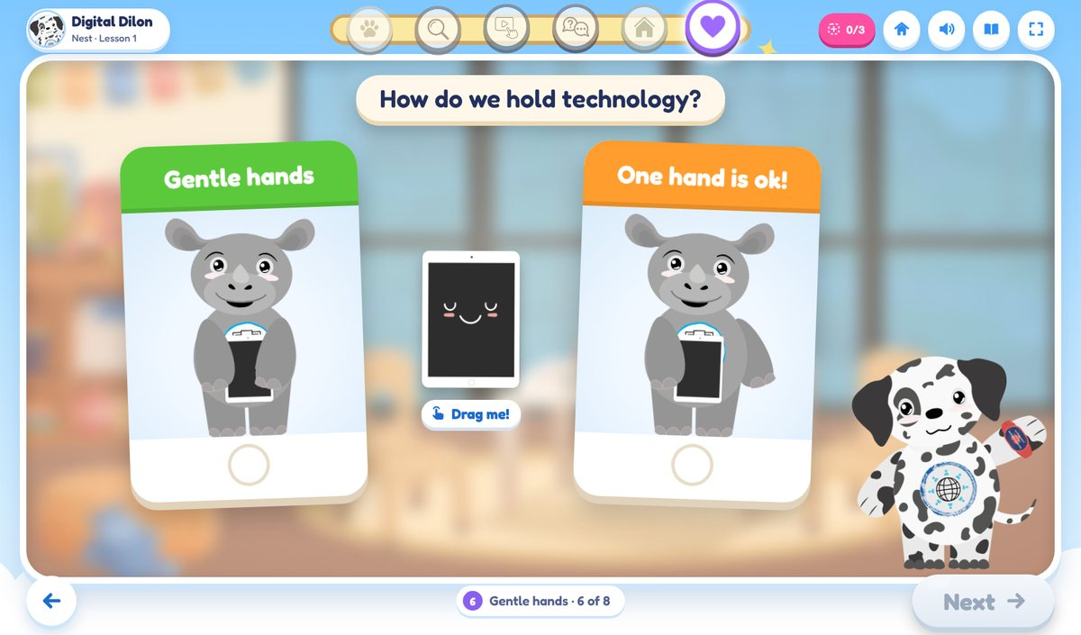




Children document. Families see it
STOP 7 · CAPTURE & SHARE
18–20 min
Snap
Children choose, with adapted grip or adult help.
Print
A few photos come off the screen and onto the carpet.
Lesson illustration
Talk back
“What were you doing? What happened next?”
Play illustration
a lesson moment
Share
Share through words, gestures, pictures or objects.
a play idea
Choose
Ask permission; check names, faces and context.
Our latest change. Children capture their own learning, print it, explain it, and can’t wait to show their parents.
Grew from Dr Nair Cordoso’s workshop, Beyond the Screen: Strategic Frameworks for Balancing Sensory Pedagogy and EdTech.
Notes:
18:00 to 20:00. Our latest change is in how technology documents learning. Children use an iPad to capture what they made with photos and short videos. Then the documentation goes offline: printed pictures they can hold, sequence and explain later. And the part they love most is sharing it with their parents.
The idea grew from a workshop I attended last weekend: Dr Nair Cordoso’s Beyond the Screen: Strategic Frameworks for Balancing Sensory Pedagogy and EdTech. The device captures the moment; the thinking happens with people.
On photos: follow your media consent, keep faces off anything that leaves the classroom, and let children choose what is printed. That is digital citizenship too. If there’s time, pairs can try the photo talk-back card in the kit (page 15).

Slide 16
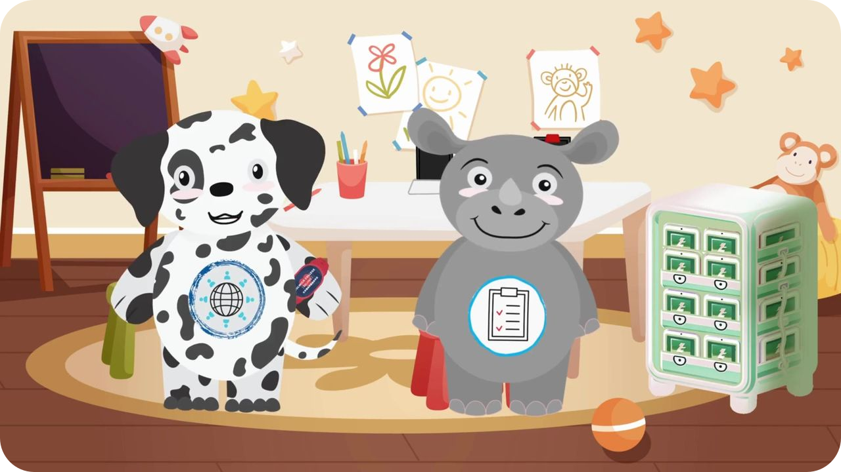

From screen to Beebot
STOP 8 · BEEBOTS & PLAY
20–24 min
→
→
1 · On screen
2 · In hand
3 · Their own
A Dilon episode says there are many ways to explore technology, and invites children to try.
Classrooms get Beebot sets, after a lesson on what robots are, themed on Rosie’s Walk.
No hesitation: children sequence, then build their own paths for their bees.
More than any animated lesson, this is the goal
Notes:
20:00. A Dilon episode about exploring technology was followed later by a tool we use on campus: Beebots. Children need little prompting to try fun-looking tech, but this time they knew they could take what the screen had shown them and use it, without hesitation, in the real world. They played, learned simple sequencing, and even created paths for their bees. More than any animated lesson, this is the goal, and it was the first place I saw the impact with my own eyes (Calvert et al., 2020, on how children learn from characters they feel close to; a small Bee-Bot pilot also found gains in working memory and inhibition, Di Lieto et al., 2017).

Slide 17
Rosie’s Walk, with a Beebot
STOP 8 · AT YOUR TABLE
4 min
1
Lay the six farm tiles edge to edge. The hen house is START.
2
One press = one 15 cm tile. Press CLEAR first.
3
Plan Rosie’s walk in story order with arrow cards. Predict, then GO.
4
Choose filming with permission, drawing or story roles.
Then ask
Nest & Nursery
Reception
Year 1–2
“How did it know where to go? Who told it?” People programmed it: the seed of “people made it”.
Move a pretend bee by hand, or program one step. Count together.
The whole walk in one program, in story order.
Move a tile. Write a program for a partner to debug.
Notes:
20:30 to 24:00. Each table has a Beebot, six farm tiles (kit pages 9–14, 15 cm each), arrow cards and the challenge card. Before the Beebots, a lesson explored what robots are, themed on Pat Hutchins’ Rosie’s Walk: a hen strolls around the farmyard, never noticing the fox behind her. Tables choose the level that matches their children. Press CLEAR before each new program.
If a Beebot fails: one person plays the robot, the others give arrow-card instructions.
As they finish: “Which frame of your film would you print for carpet time tomorrow?” That links back to capture and share.

Slide 18
Where play and AI literacy overlap
STOP 8 · MOMENTS OF PLAY
The same loop works from Nest to Year 2. What changes is who holds the device, and how much children explain.
 | Nest & Nursery | Reception | Year 1 | Year 2
Story | A two-minute Dilon clip on the carpet | “Remember when? What did Dilon ask us?” | A story where a character uses an app | A story we credit: whose idea was it?
Play | Battery-free pretend tech in role play | Beebots on a story mat; a pretend speaker | Beebot routes for a partner to debug | A maze with instructions for another team
Capture | The adult holds the iPad; the child points | Children capture a path with adapted support | A short “how we did it” clip | Ask before filming a friend; add a caption
Talk back | One printed photo: “What were you doing?” | Sequence three prints: first, then, last | “What would you change?” | Photo plus their words, shared at pick-up
Home | Return things to Dilon or a grown-up | Charging-cabinet helpers | An “apps we use” wall | A class agreement for devices
Notes:
Reference slide; leave it up briefly or skip if time is tight (it’s on the companion site under Capture, share and play). Story, play, capture, talk back, home, and round again. Two questions do most of the work: what does the screen add, and what does it displace? And would this still be worthwhile without the tech label?

Slide 19


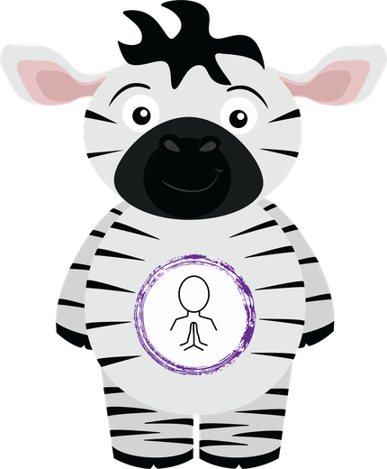
Make it yours
CHAPTER 3 · STOPS 9–12
Your learners, your rooms, your character and your plan
9 The playhouse
10 Make Dilon yours
11 Check & build
12 Families
Notes:
24:00. Transition. “The last twenty minutes are yours.”

Slide 20
Walk through the playhouse
STOP 9 · THE PLAYHOUSE
24–31 min
1
Who are your learners?
Start where they are: Nest, Reception, Year 1 or Year 2.
2
Walk the rooms
Each room keeps the play first and adds a precise lens.
Story carpet
Home corner
Art studio
circle time and books
role play
drawing and making
3
Pick moments that fit
What can your children already do? Circle the one you’ll start with.
Build & move
Tech station
Garden
Reception · Home corner A pretend smart speaker that can only say what’s on its card. “Who made it say that?”
blocks and Beebots
Dilon’s station
outdoors
Notes:
24:00 to 31:00. Seven minutes. Every early years setting is a house of rooms: a carpet, a home corner, blocks, an art table, a garden, a place where technology lives. Choose your learners, walk through the rooms on the site (or the A3 playhouse mat), and pick the moments that fit where your children are and what they can do.
Circulate and ask: would this still be worthwhile without the word “technology”? If not, choose a different one. On the site, “Add to my plan” sends ideas straight to page 2 of the plan PDF.

Slide 21
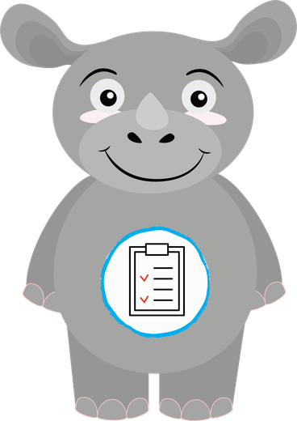
Seven steps to your own values friend
STOP 10 · MAKE DILON YOURS
31–35 min
1
Start with the values you have
5
Write its card
At DCB: The DUCKS values friends were already in every Early Years room.
At DCB: The same card as every friend: “I can”, questions, books, songs.
2
Find the gap in children’s lives
6
Keep it openly pretend
At DCB: The seven friends needed one for digital citizenship and safety.
At DCB: Dilon and the friends don’t exist like we do, so we say bye.
3
Choose a character for your culture
7
Bring it off the screen, let it grow
At DCB: A cartoon dalmatian, drawn to sit beside the seven friends.
At DCB: A poster, a video, lessons Nest to Year 2, and now a plush.
4
A name and one big question
At DCB: “How do we stay safe and responsible when using our iPads?”
Notes:
31:00 to 33:00. You don’t need a dalmatian. You need a values character that grows from your campus and culture, carries one big question, and stays openly pretend.
Step 6 is the safeguard: teacher-voiced and scripted, it can’t answer back, remember children or follow them home, and it always says goodbye. Step 7: partner it with existing friends, grow it from your youngest class upward, and check in on how children respond. Making Dilon was surprisingly easy: he was in my mind’s eye before I opened Illustrator.

Slide 22
Draft your character card
STOP 10 · YOUR TURN
2 min
The one big question it asks
I can… (what children can say and do)
Questions adults ask
Draw your character
Books, songs and words that mean the same
Name · animal · the value it belongs to
Where it lives, and how it says goodbye
Notes:
33:00 to 35:00. Two minutes to start a card, on the site (Character page) or kit page 18. It’s the same card DCB uses for every DUCKS values friend. On the site it saves straight onto page 2 of the plan PDF. Nobody needs to finish today: the big question is the part to get right.

Slide 23
Where are we now?
STOP 11 · CHECK
35–38 min
0
1
2
3
0
Not yet
1 Shared values & stories
Rarely, or by chance
1
Noticing
2 Tech has a home
Adults name moments
3 Play before screens
2
Inviting
Planned in routines
4 Capture & share
3
Embedded
Shared and revisited
5 Honest, precise language
Download my audit (PDF)
Adult provision. Use N/A where needed.
6 Families in the loop
Notes:
35:00 to 38:00. Come back to your own setting. For each area, pick the description that matches what a visitor would actually see this term. It’s about adult practice and children’s opportunities, never children’s readiness, and a low score just shows where one small change will matter most.
On the site the lowest area becomes the suggested first step and carries over to Build. Paper: kit pages 19–20. How will you know it made a difference? Compare one small, observable feature before and after: do children return technology to its home without a reminder?

Slide 24






Where can we go?
STOP 11 · BUILD
38–42 min
Today: one idea, one priority, one step. Finish the strand later.
Our first paw-step
1 · Hello
2 · Hunt
3 · Watch
One step
One date
One colleague (a role, not a name)
The friend or story that carries it
What will children notice?
The short screen moment, if any
4 · Talk
5 · Home
6 · Heart
Swap with the next table. Leave two paw-prints: “This will work because…” and “One next paw-step could be…”
Your adult prompt, then wait
Where it lives in your routines
The family echo and the promise
Every plan answers: Where can a child change the plan? How can a child join without words?
Download my plan (PDF)
Your ideas and character, plus continuation pages.
Notes:
38:00 to 42:00. Start from your lowest area, or a seed card. Walk it through the six stops: hello, hunt, watch, talk, home and heart. Then one first paw-step: one step, one date, one colleague.
At 40:00, swap with the next table for two paw-prints of feedback (written on the printed plan, or typed on the site). One practical revision per plan is the goal. The plan downloads as a filled-in PDF, with the six stops on page 2 and the playhouse ideas and character card on page 3.

Slide 25
Mirrors of the community
STOP 12 · FAMILIES
42–45 min
Questions to try at home · 在家试试这些问题
A family session
Is it technology?
Where does our technology live at home?
30 minutes, one topic, from your strand
这是人们制作的工具或设备吗？
我们家的工具和设备放在哪里？
5
Hello
Meet the character and the question
A safe grip or adult help.
A person, toy or machine? More than one label?
10
Look
Children’s printed photos and words
轻轻拿稳；可用支架或请成人帮忙。
是人、玩具或机器？可以不止一类。
10
Try
One home routine
Who made it say that?
How could we check?
5
Take home
是谁让它这样说的？
我们怎么查一查对不对？
A bilingual sheet, one question
Notes:
42:00 to 43:30. Families are children’s first windows and mirrors. We’re not asking them to adopt technology or give it up; we’re inviting them into the questions children already ask, in the languages home already speaks. The questions go home in English and Chinese (ask a colleague or family volunteer to check wording for your community).
DCB’s Sip & Support sessions follow a simple shape: monthly, about 30 minutes, one topic and a take-home sheet. For early years, the topic can come straight from your strand. The family note is on kit page 27 and on the Families page of the site.
Technology means human-made tools and devices, including non-electronic tools. Toys and machines can overlap; invite more than one label. Offer gestures, home languages and supported access.

Slide 26



Six small things families can do
STOP 12 · GUIDANCE FOR PARENTS
1 · A home for technology
2 · Safe, supported handling
3 · Talking toys and speakers
One spot where devices live and charge.
Use a safe grip, stand or adult help to suit your child.
Never share a name, address, school or photo. Grown-ups check settings.
给电子产品一个固定的“家”。
轻轻拿稳；可用支架或请成人帮忙。
不透露名字、地址、学校或照片。成人负责检查隐私设置并监督使用。
4 · Pretend is pretend
5 · Look at their photos together
6 · “I’m not sure, let’s check”
Love characters, and still say “people made it say that”.
“Show me what you made.” Then: “Okay to share?” Don’t post other children online.
When a speaker answers, wonder aloud how to check.
是谁让它这样说的？
能给我看看你做的东西吗？不要把有其他孩子的照片发到网上。
我们怎么查一查对不对？
Precise isn’t cold: “It knows you” → “It uses what we chose before.” “It’s really smart” → “It’s good at some jobs and gets some things wrong.”
Notes:
43:30 to 44:00. Short enough for a newsletter, a WeChat group or the back of a photo that goes home. Warmth belongs to people. Machines need checking. The full “say this, not that” list is on the Families page.

Slide 27
Before the pop-up appears
BACK TO THE DOOR
When a character app says “this is not a real person”, I want children to have already played through what that means, with a pretend friend who never pretended to be real.
Move your dot on the door chart.
Read one paw-step aloud per table.
Take your audit, your plan and your date home.
Notes:
44:00 to 45:00. Everyone moves their dot. Name what you see on the chart. One paw-step read aloud per table if time allows.
Close: the children bonding with a Dilon today are the children who will meet genuinely responsive AI companions in a few years. The youngest children need digital and AI literacy built for who they are right now, through narrative, play and a character they can bond with, not a thinned-down version of the Year 5 lesson.

Slide 28
Thank you
ACAMIS ECE 2026
Small moments. Thoughtful choices.
Tim Pyles · Mister Pyles
timothy.pyles@gmail.com
Next for me: exploring Byte, a dog character that helps children practise checking AI answers.
www.misterpyles.com
Notes:
Leave this up as people leave. Everything is on the companion site: the drawing activity, the playhouse, the character card, the two pre-filled PDFs, family resources and the printable kit, with an Adult lens for leaders. Invite people to share how their first paw-step went.

